Slide 1
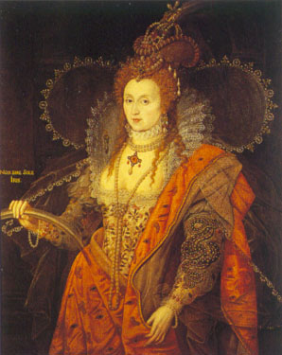
Elizabethan England

Slide 2
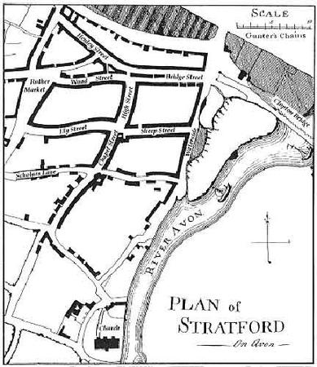
Stratford Upon Avon in 1600
Other Stratford Facts
The shape of Elizabethan towns, including Stratford, was based on a grid pattern of streets. The streets branched out off a main street which was usually the main road through the town.
Stratford is built on the banks of the River Avon, which is why it is called Stratford Upon Avon. The town grew in size and prosperity after a bridge was built across the river.
Some of the streets in Stratford were names after the markets that were held there of the types of shops and businesses. For example, Sheep Street, Rother Street (Rother is the old English word for cattle), Corn Street or Swine Street (Pig Street!!). Some of these street names still exist in modern day Stratford.
In Shakespeare’s time Stratford Upon Avon was famous for ‘malting’. Malting is the grinding and roasting of barley grain used to brew beer.
Stratford Upon Avon was classed as an important market town, and Shakespeare’s time it would have had a population of about 2500 people which was quite big in those days.
Market day in Stratford was a Thursday, and the town would have been very busy with buyers and sellers. Most people walked everywhere and did not even own a horse and cart so they had to do all their shopping in towns very close to home.
Market stalls and shops would have included shoemakers, wheelwrights, blacksmiths, bakers and fruit and vegetable sellers

Slide 3
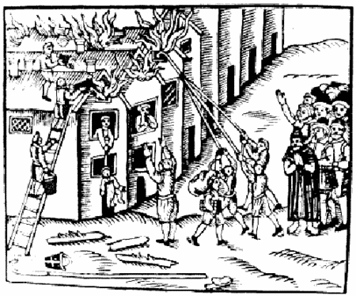
The Stratford Sentinel
October 1595
Town Devastated by Fire for Second Time
A second disastrous fire has swept through the centre of Stratford destroying more houses and businesses. Adding to the damage caused by last year’s fire, it is estimated that as many as 120 houses have been destroyed.
The fire has been blamed on shoddy and ramshackle houses built by the migrant poor who have been flooding into Stratford over the past few years.
A corporation spokesperson said: “Buildings made of timber and thatch pose a constant risk from fire, and we would ask the good people of Stratford to be vigilant in extinguishing their cooking
fires to
Prevent
Further
tragedy.”
Man fined for causing public offence.
People thinking they can dodge the law and dump their toilet waste in unofficial “muckheaps”, be warned. A well to do local business man has been fined by the town magistrate for making a muckheap near his house instead of using the public muckheap on the outskirts of the town.
A spokesperson for the town council said: “The public muckheap has been set up in a place least likely to cause offence from its odours and vapours. We will not tolerate unofficial muckheaps.”
Stratford Corporation Powers
Clarification of Stratford Corporation’s powers were outlined earlier this week. The corporation controls the markets within the town and has made bye-laws to prevent “nuisances” in the town and impose fines on those citizens who break the bye-laws or cause a nuisance. Any offences like failing to attend church, drunkenness or sorcery will be dealt with by the Church Court headed by the bishop.

Slide 4
The Bard Tavern
Menu
Breakfast
Manchet: finest quality white bread
Cheat : ordinary white bread
Simple: brown bread
Frumenty: wheat porridge
Flummery: boiled oatmeal
Meat
Game: Rabbit, Hare, Venison
Fowl: Lark, Curlew, Chicken
Meat: Mutton, beef, lamb.
Pudding
Quaking Pudding: Custard and breadcrumbs
Sack Posset: Cream dessert with Madeira wine
Drinks
Beer: Made with malted hops
Apple Cider: Made with local apples
Sack: Dry Spanish wine
Cordial Waters: Weak spirits

Slide 5
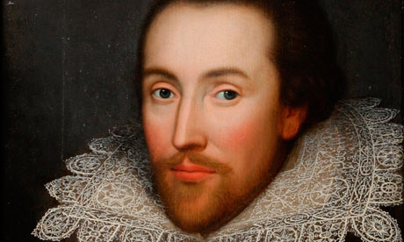
Life and Times
Of William Shakespeare

Slide 6

Certificate of Birth
Born this day April 23rd in the year of our Lord 1564 in Stratford Upon Avon, in the most glorious County of Warwickshire.
A boy, William, to John Shakespeare Esquire, esteemed Glovemaker and Wool Merchant, and his wife Mary (nee Arden).
His name shall be entered in the dockets and records of the Town Hall of Stratford Upon Avon as decreed by the laws of Her Majesty Queen Elizabeth 1.
Witnessed April 24th in the year of our Lord 1564.
ER

Slide 7
Shakespeare at School
Grammar School
The sons of the richer citizens would move on, at the age of seven, to grammar school (girls were not educated in schools). As a prosperous craftsman, businessman and leading townsman, John Shakespeare would have made sure that his son attended the grammar school in Stratford.
School hours were 7 am in the morning until 6pm in the evening and boys attended school 6 days a week (Monday to Saturday) Although there was a break of a couple of hours in the middle of the day, there was no PE or play included in the timetable and no holidays except for the occasional day's holiday. On Sundays, the boys had to go to church .
Shakespeare would have learnt all his lessons in Latin. This was the international language of Europe, used throughout the professions, in the law, in medicine and in the Church, and, boys were expected to be fluent in Latin to go into jobs like lawyers, doctors or priests in the church.
Their lessons were grammar, logic, rhetoric, arithmetic, geometry, music and astronomy.
The town's petty school was like primary school for William Shakespeare and the other five-year-olds of Stratford-upon-Avon.
Children were taught to read using simple 'abc books‘ which included the Lord's Prayer, the Creed and the Ten Commandments. There were no pens or pencils in Shakespeare’s time, so to learn to write, children had to use a quill pen and ink.
A quill pen was made from a bird’s feather.

Slide 8


The Stratford Sentinel
December 1582
Local playwright Marries
William Shakespeare (18) married Anne Hathaway (26) in November. The groom is the son of John and Mary Shakespeare and the bride, the daughter of local farmer Richard Hathaway.
Brothers and sisters
The couple were married at the local parish church in Stratford Upon Avon where the groom’s 3 brothers were best man and ushers. His sister Joan was a bridesmaid. His other sister Ann died in childhood.
Pig sold for record price at auction
Father of the bride, Richard Hathaway had more good news today after his prize Gloucester Old Spot pig recorded a record price at the local Stratford Upon Avon livestock Auctions.
The pedigree pig was sold for 3 duckets and Mr. Hathaway said “that prize pig is worth its weight in gold and has helped me pay the dowry for my daughter Anne’s weeding to Mr. Shakespeare.
Tax on Cider
Local pub go-ers were outraged last week when the government announced a new higher tax on cider. Local apple grower and cider maker Mr. Jacob Swithinbank said “it’s an outrage for the hard working people of England that an essential commodity like cider should be taxed to this level.”
Stratford Livestock Auctions.
Every Monday, Wednesday and Friday on the town green. For the
best prices on pigs, cattle and sheep.

Slide 9
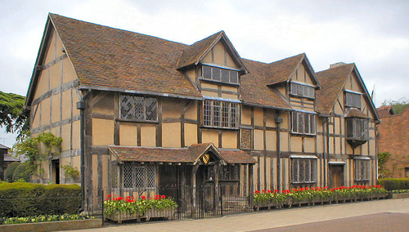
New Place in Stratford-Upon-Avon
Last Years in Stratford Upon Avon
Shakespeare’s elder daughter, Susanna, married John Hall, a Stratford doctor in 1607. His other daughter Judith married Thomas Quiney in 1616. She was born a twin, but her brother Hamnet, Shakespeare’s only son, died aged 11.
From around 1611, Shakespeare seems to have retired from London theatre life and spent most of his time at his house, “New Place”, in Stratford.
He died in Stratford on 23rd April 1616 aged 52 and was buried 2 days later in Holy Trinity Church. Within a short time, a monument was put up on the wall close to his grave.
His wife Anne died in 1623 and is buried beside him.

Slide 10
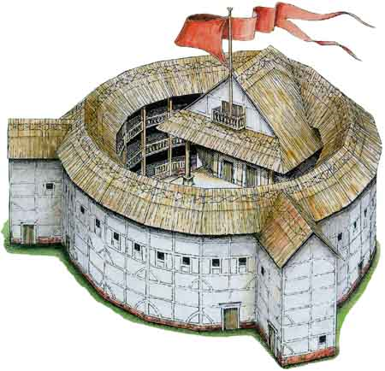
Elizabethan Theatre

Slide 11
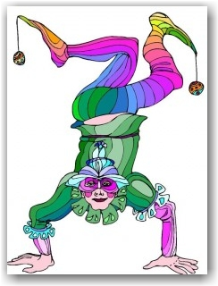
Street Entertainment
By Royal Approval
Queen Elizabeth I loved theatre and if she visited the theatre, she would have sat the Gentleman’s Rooms, a private box in the galleries.
Ordinary people could not afford to sit in the more expensive seats in the tiers of the Globe, so would pay to watch a play in the standing area at the front of the stage. This was the cheapest area and the people that watched from here were called groundlings.
The Globe is the most famous Elizabethan Theatre and it was owned and built by William Shakespeare. The Globe theatre that exists in London today is an exact reproduction of Shakespeare's original Globe.
Shakespeare’s theatre company was called ‘The Lord Chamberlain’s Men’.
After Queen Elizabeth I’s death, King James I took to the throne. He loved theatre too and in particular the works of Shakespeare. He sponsored Shakespeare’s theatre company and they came to be known as The King’s Men.
The Elizabethans were very fond of any type of entertainment and they had plenty of ways of enjoying themselves. Street theatre like acrobats, jugglers and musicians would play in streets.
Other, more gruesome forms of entertainment that always attracted crowds were public hangings or executions.
Another cruel sport that the Elizabethan’s enjoyed was animal fighting. Special arenas or yards were built with galleries all around where people could pay to see how many dogs would dare to attack a fierce bull or huge bear. This was called bull or bear baiting.
Queen Elizabeth I had her own bull and bear master to organise these tournaments.

Slide 12
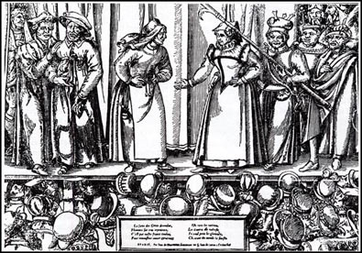
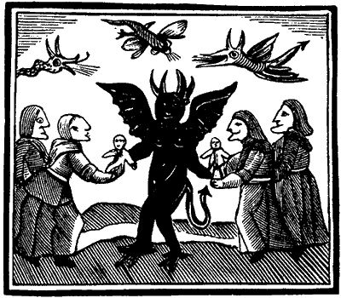
Blood, Guts and Other Special Effects
Elizabethan audiences loved blood, gore and guts. Popular plays of the day were full of witches, wizards, ghosts, murders and battles and the actors used lots of ingenious ways to create special effects.
For example, to recreate the effect of someone being killed in battle, actors used bladders full of pigs blood which burst when another actor pretended to stab them.
The sound of thunder was created by rolling a cannon ball across the floor at the back of the stage or above the stage.
Sometimes a trap door in the heavens was used to fly characters down to the stage, looking like they had appeared from the sky.
If the audience was not impressed with a show, they could add their own ‘special effects’ like boos and hisses and throw rotten fruit, vegetables and eggs at the actors!
In Elizabethan Theatre, all of the parts were played by men. Young men played the parts of women and girls while older men may have had parts like witches, wizards or hags.
Women and girls were not allowed to act.
Actors generally wore Elizabethan dress as costumes. They were very elaborate and sometimes very expensive. For example, costumes made of silk, satin and velvet and embroidered with gold and silver thread were often worn.
If a play was set in historical times like Shakespeare’s play Cymbleine which was set in Roman times, actors may have worn Roman style costume so that audiences knew the characters were Roman.

Slide 13

The Globe
The stage in the Globe theatre was open on three sides.
At the back of the stage there were doors for actors to make their entrances and exits.
There was a trap door in the floor of the stage which was used in particular for characters like witches and ghosts to “appear” or “disappear”.
The stage was usually called an “apron stage” because it stuck out into the audience like an apron.
At either side of an Elizabethan Theatre stage, there were two pillars to support the stage roof, but they were also used as part of the play by providing hiding places for characters.
The balcony above the stage was used by musicians who played during the performance or for scenes in plays like the balcony scene in Shakespeare’s Romeo and Juliet.
Theatres like the Globe could hold up to 2500 people, but as there were no lights, shows were put on during daylight hours. If there was a scene in a play that was supposed to be at night time, the actors would let the audience would know through words or actions. For example, in Macbeth, one of the lines that lets the audience know it was set at night is “How goes the night boy?”

Slide 14
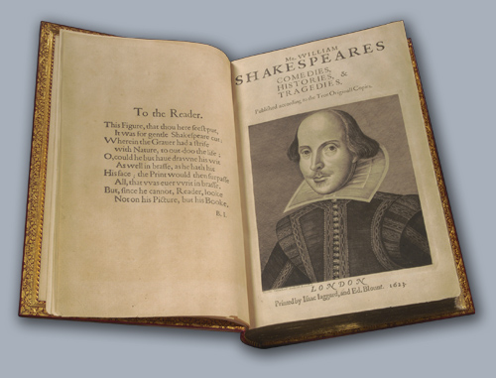
Shakespeare’s Works

Slide 15
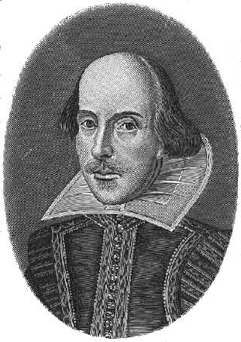
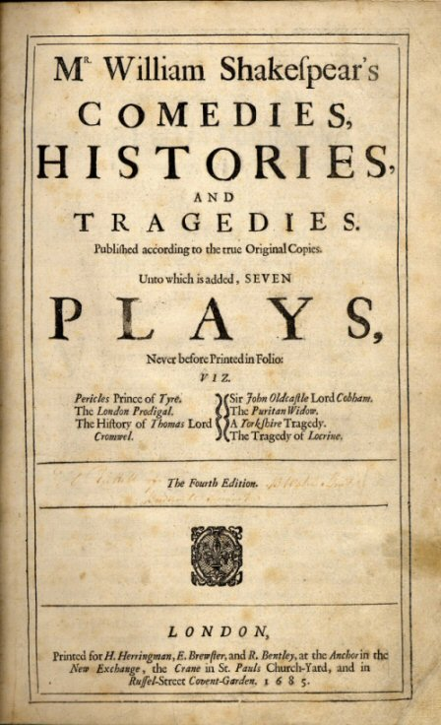
Trivia
It is thought that Shakespeare wrote at least 37 plays. They fell into 3 categories: comedies, histories and tragedies.
He also wrote 154 sonnets. These are long poems made up of 14 lines. They get their name from the Italian for ‘Little Song’.
The character of’ Bardolph’ appears in 4 of Shakespeare’s plays: Henry IV Part 1, Henry IV Part 2, Henry V and The Merry Wives of Windsor.
Shakespeare took the plots and stories for many of his plays from existing stories or events from history. For example, his play Julius Caesar and Anthony and Cleopatra were based on the events and lives of the ancient Romans.
Shakespeare’s works have been translated into over 80 languages.
Today, there is a theatre company based in Stratford that performs only plays written by Shakespeare. It is called the Royal Shakespeare Company.
Shakespeare’s longest play is Hamlet, and the shortest is The Comedy of Errors.

Slide 16
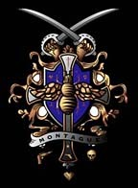

Romeo and Juliet
Two rival families live in the city of Verona in Italy, the Capulets and the Montagues. The families hate each other. Romeo is a Montague boy and is about 16 years of age, and Juliet is a Capulet girl of about 14.
Juliet’s father wants her to marry Count Paris and throws a party to introduce them to each other. Romeo and his friends hear about t party and decide to go in disguise. At the party, he meets Juliet and they fall madly in love with each other. Because the families hate each other so much, Romeo and Juliet decide to get married in secret.
The two families continue to fight and Juliet’s cousin Tybalt picks a fight with Romeo’s best friend Mercutio. Romeo tries to stop the fighting, but his friend Mercutio is accidentally killed by Tybalt.
In anger Romeo kills Tybalt and is banished from Verona as a punishment. Juliet does not know about the fight, but when she finds out, the kindly Friar who married them arranges for her and Romeo to spend one last night together before Romeo is sent away.
Meanwhile, her father, who still does not know she is married to Romeo, decides to bring her wedding to Count Paris forward to try and make the family forget Tybalt’s death. Juliet tells her mother and father she does not want to marry Count Paris, but still does not tell them why. Her mother and father are very angry with her.
Juliet goes to Friar Lawrence again and together they plan a way that Romeo and Juliet can let their families know they are married. He gives Juliet a sleeping potion that will make her seem dead. When he father and mother go to wake her in the morning they are think she has died in her sleep.
The Friar sends a message to tell Romeo to come to the Capulet's family monument to rescue his sleeping wife. But the message gets mixed up and Romeo believes Juliet is really dead. He is so sad that he buys some poison in order to kill himself.
He returns to Verona and goes to the tomb where Juliet lies sleeping. Count Pairs is also there and Romeo, blinded by anger and love, kills him. Romeo then takes the poison and dies just as Juliet wakes from her drugged sleep.
Friar Lawrence tells her what happened but she refuses to leave Romeo and stabs herself.
The deaths of Romeo and Juliet lead the families to make peace.

Slide 17
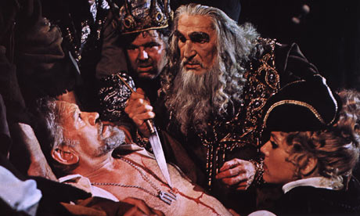
The Merchant of Venice
An Italian man Bassanio needs money impress a girl called Portia. He asks his friend Antonio, the Merchant of Venice to lend him the money.
Antonio agrees but is a bit short of cash as it is all tied up in his ships which are at sea, so he suggests that Bassanio borrows the money from one of Venice’s moneylenders and says he will the loan back from Bassanio.
They approach a Jewish money lender called Shylock for the loan. Shylock and Antonio go way back, but they don’t like each other – Antonio has insulted Shylock on many occasions.
Shylock lends the money, but says if it is unpaid, then he wants a pound of Antonio’s own flesh. Antonio agrees to the terms of the loan.
Meanwhile , Portia’s father has decided on a task for any man who wants to marry his daughter. They must choose a box and if they make the right choice, they can marry Portia – so far no one has chosen correctly.
Bassanio arrives at Portia’s estate and they fall in love with each other. Fortunately, he also picks the correct box . Portia gives him a ring as a token of their love and makes him swear he will never part with it.
News arrives that Antonio’s ships have been wrecked and Shylock is after his pound of flesh. Bassanio returns to Venice to try and save Antonio’s life. Unknown to him, Portia follows disguised as a man.
Portia examines the contract and says it is legal, but warns Shylock that the contract does not mention any blood, so she tells Shylock he can have his pound of flesh if he does so without spilling any of Antonio’s blood.
Shylock is told he has to pay Antonio for the upset he has caused, but Antonio refuses his money saying he wants Shylock to convert to Christianity instead – Shylock reluctantly agrees.
Bassanio goes to thank the lawyer (Portia in disguise) and gives him the ring as gratitude. Portia reveals who she really is and tells off Bassanio for giving away the ring.
Antonio’s ships tern out not to have been shipwrecked and they all live happily ever after!

Slide 18

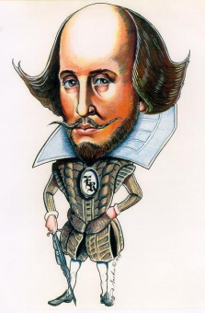
The Seven Ages of Man
William Shakespeare is England’s most famous writer. He loved plays that much that he once said life was a bit like a play and we go through life in seven scenes. In his play As You Like It, the character Jacques says the famous Seven Ages of Man speech.
If we could put the life of Shakespeare into seven scenes, maybe it would
look a bit like this.
“All the world’s a stage ,
And all the men and women merely players:
They have their exits and their entrances;
And one man in his time plays many parts,
His acts being seven ages.”
ACT 1: “At first the infant,
Mewling and puking in the nurses arms.”
April 1564: William Shakespeare is born.
ACT 2: “Then the whining schoolboy, with his satchel,
And shining morning face, creeping like a snail
Unwillingly to school.”
Shakespeare attends his local grammar school.
ACT 3: “And then the lover,
Sighing like a furnace, with a woeful ballad,
Made to his mistress’ eyebrow.”
Shakespeare marries Anne Hathaway when he is 18.
ACT 4: “Then a soldier,
Full of strange oaths, and bearded like the pard,
Jealous in honour, sudden and quick in quarrel,
Seeking the bubble reputation,
Even in the cannon’s mouth.”
Shakespeare makes his way to London in May 1592 and fights to make his way and his name in the theatre.
ACT 5: “And then the justice,
In fair round belly with good capon lined,
With eyes severe and beard of formal cut,
Full of wise saws and modern instances;
And so he plays his part.”
Shakespeare has become a successful playwright and his plays are famous in London. He has bought a family home “New Place” with his wealth.
ACT 6: “The sixth age shifts
Into the lean and slippered pantaloon,
With spectacles on his nose and pouch on his side,
His youthful hose well saved, a world too wide
For his shrunk shank; and his big manly voice,
Turning again towards childish treble, pipes
And whistles in his sound.”
Shakespeare has retired from theatre life in London
ACT 7: “Last scene of all,
That ends this strange and eventful history,
Is second childishness and mere oblivion,
Sans teeth, sans eyes, sans taste, sans everything.”
Shakespeare is a grandfather now and dies in 1616 an old man of 52 (it was old in those days).

